Slide 1
Accessing the Curriculum for Diverse Learners
Numeracy Development

Slide 2
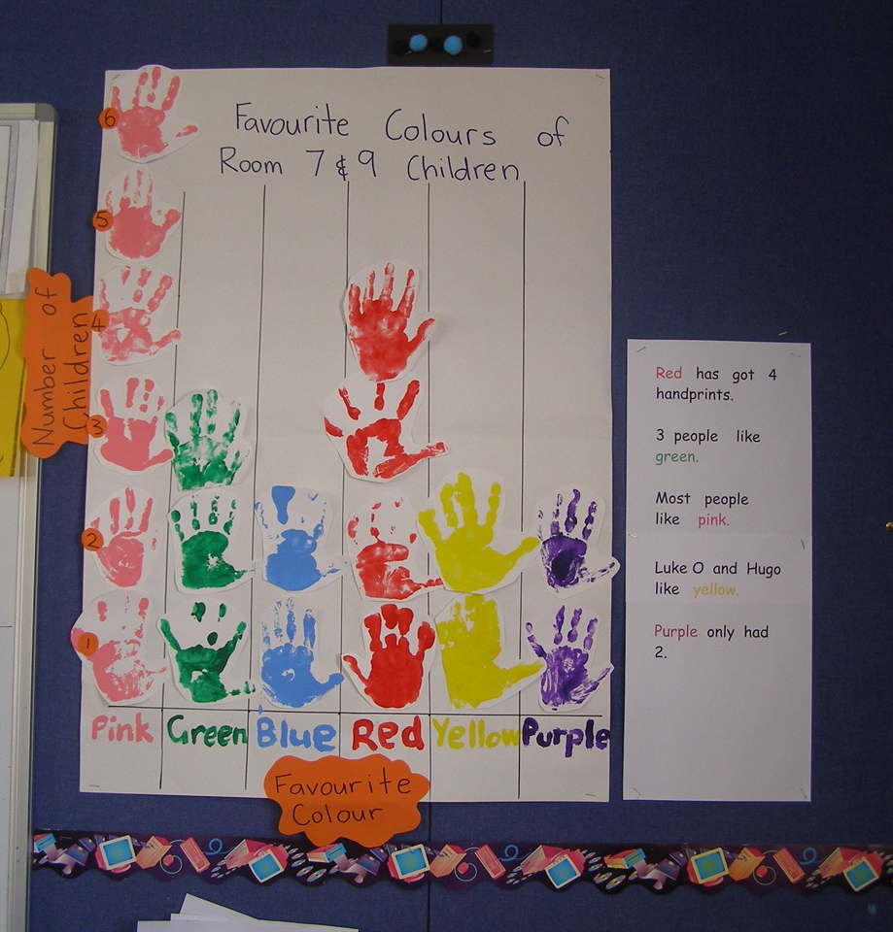
Activity

Slide 3
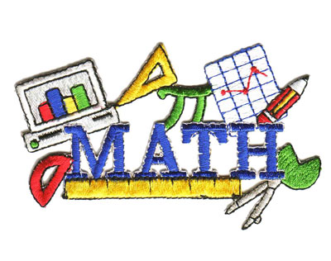
Numeracy
“the combination of mathematical knowledge, problem-solving and communication skills required by all persons to function successfully within our technological world. Numeracy is more than knowing about numbers and number operations.” (BC Association of Mathematics Teachers 1998)

Slide 4

Everyday applications
Examining surveys or poll results
Reading the weather report
Estimating how much to tip
Adapting recipes when cooking or baking
Negotiating loans and mortgages
What else?

Slide 5
Numeracy Development
Emergent | Early | Developing | Expanding | Established

Slide 6
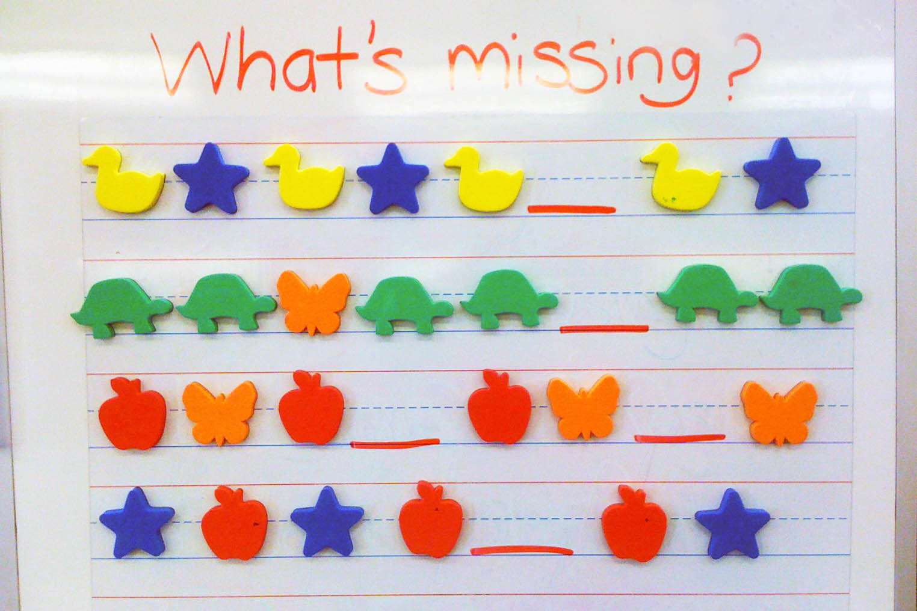
PLO Organizers
Number
Patterns and Relations
Patterns
Variables and equations
Shape and Space
Measurement
3-D objects & 2-D Shapes
Transformations
Statistics and Probability
Data analysis
Chance and uncertainty

Slide 7

What makes math difficult for some students?
Communication challenges
Math requires reading, writing, discussing
Strategy deficiencies
Not being able to perform basic operations
Lack of past instruction
Focus only on functional math like money skills

Slide 8
What makes math difficult for some students?
Memory challenges
Math facts, math concepts
Attention problems
“miss” important information or do not attend in a meaningful way to essential cues when problem solving
Cognitive-processing problems
Difficulty “interpreting” what they see or hear

Slide 9

The last 30 years
Only functional math
Pick and choose math activities
Theme-driven instruction
Lack of appropriate, high quality materials

Slide 10
What’s wrong with all that?
Limits potential
Increases confusion and frustration
Decisions based on assumptions related to disability category (not seeing the individual)
Gaps in learning
Lack of access to opportunities
What else?

Slide 11
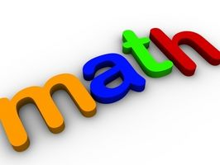
When thinking about numeracy development
IEP goals are not the curriculum
Playing math games is not instruction
Teaching concepts, vocabulary, thinking skills and understanding along with practice opportunities is math instruction
“Concept knowledge is as essential to math as comprehension is to literacy”.

Slide 12
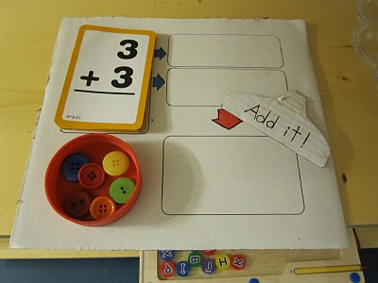
What works …
Ensuring instruction moves from the concrete, to the representational, to the abstract
Directly modeling (including think-alouds) both general problem-solving strategies and specific learning strategies using multisensory techniques

Slide 13
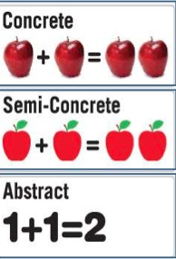
Sequence of Instruction
Concrete = teach with hands on manipulatives and sensory experiences
Semi-concrete = teach with representational materials to bridge concrete objects and abstract numbers
Abstract = teach with numerals, signs and symbols

Slide 14
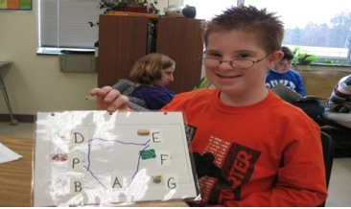
What works …
Systematic and explicit instruction
Visual and graphic depictions of problems
Giving students opportunities (student think-alouds) to use their language to describe their mathematical understandings
UDL

Slide 15
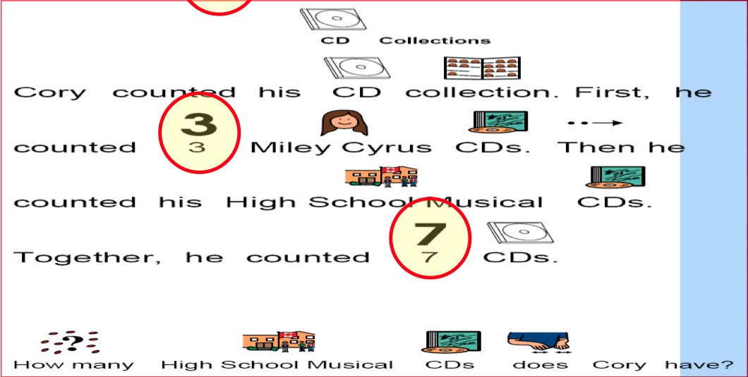
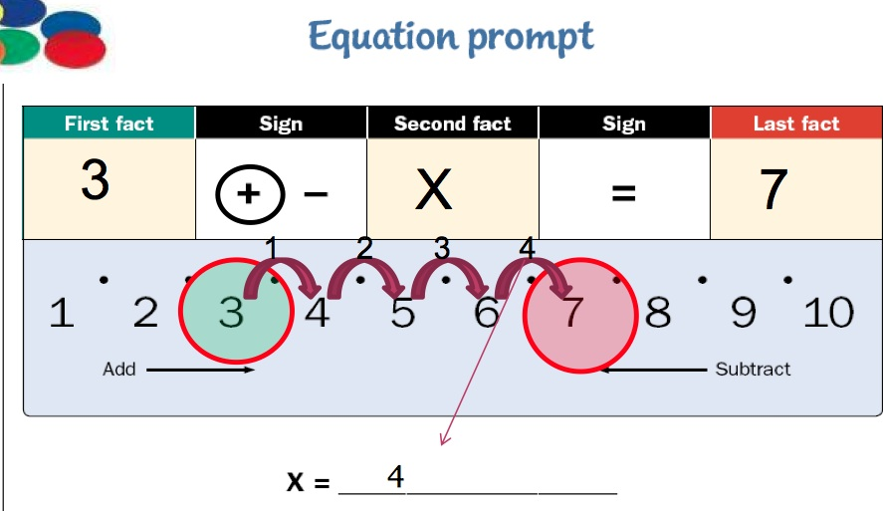
Break skills down

Slide 16
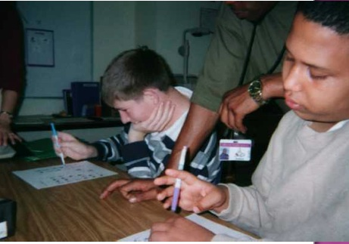
What works …
Providing multiple practice opportunities to help students use their developing mathematical knowledge and build proficiency
Offering meaningful feedback
Using authentic and meaningful contexts

Slide 17

What do you know already?

Slide 18
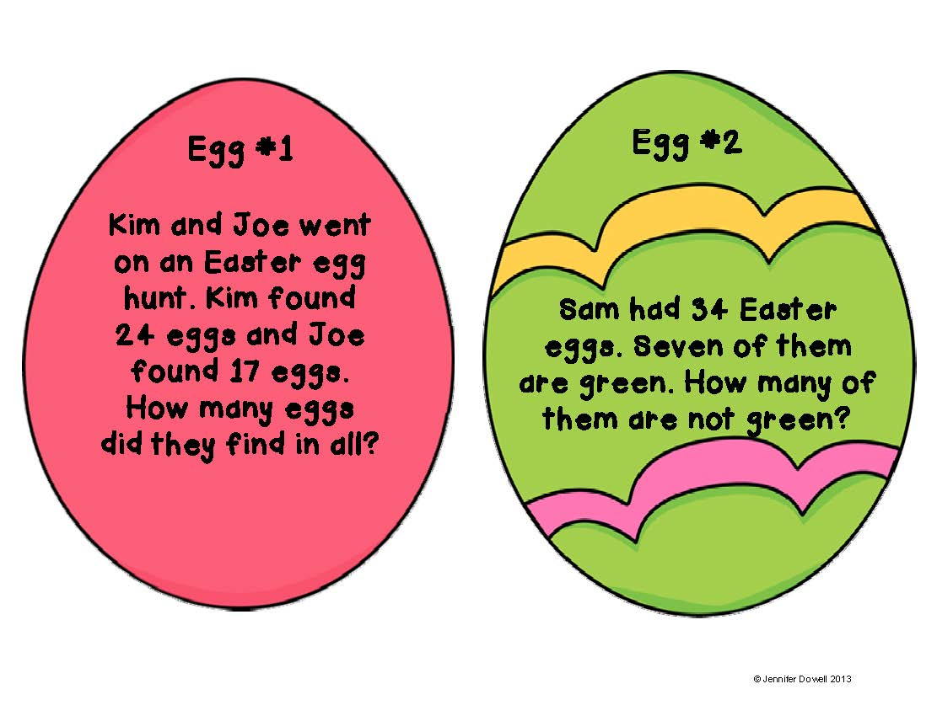
Word Problems
Begin with a problem that has real meaning to student’s life
Present it as a story
Search for facts
Use math symbols to represent the problem (and / or create visual)
Solve the problem using mathematics
Write answer in numerical form and / or in a sentence.

Slide 19
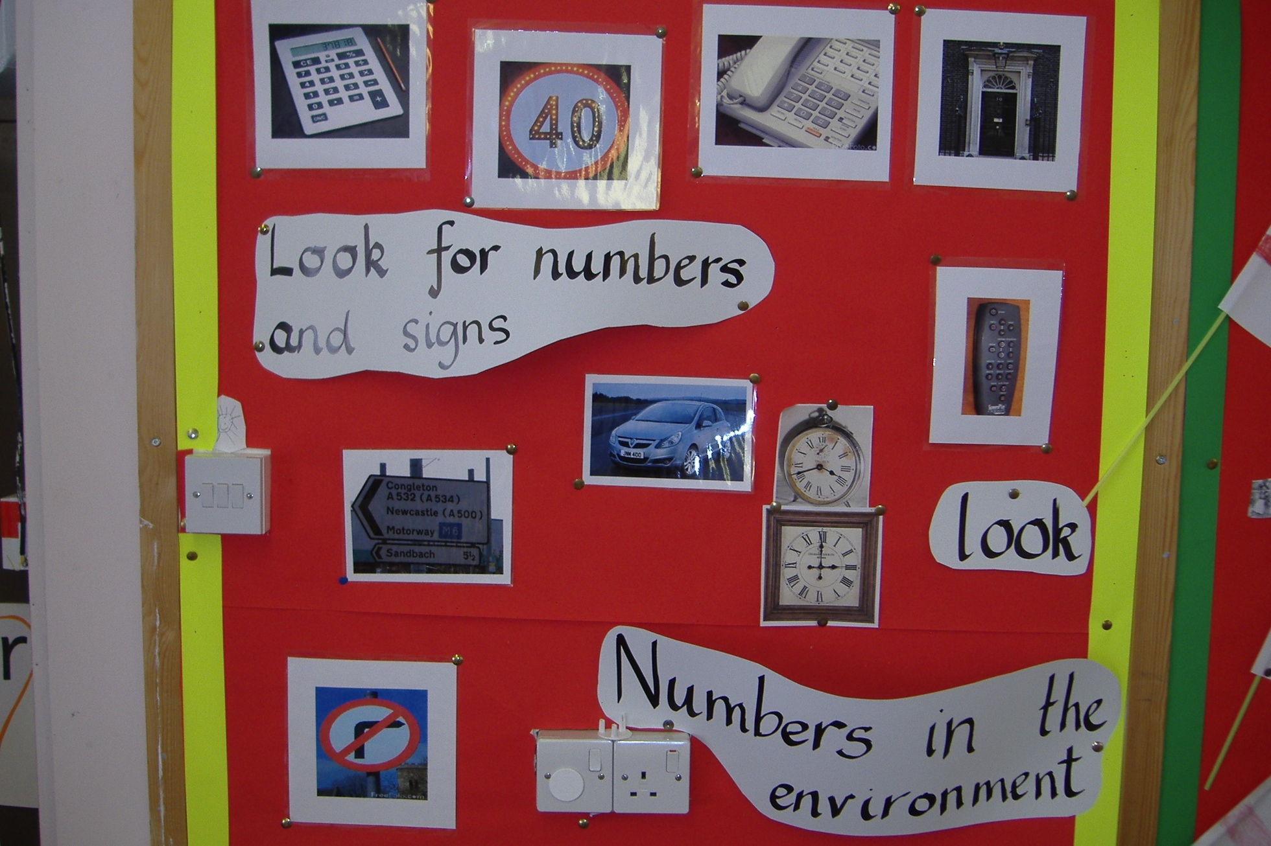
Environmental Print

